Slide 1
Project 4: Causal Inference Algorithms Evaluation
Group members: Elise Nguyen, Natalie Williams, Rohan Uppuluri, Mina Jiang,
Xinying Feng, Tianle Zhu

Slide 2
Outline of presentation
Explanation algorithms:
Full matching: Mahalanobis, Propensity Score, Linear Propensity Score
Inverse Propensity Score
Stratification
Evaluation method: ATE score & Computational Efficiency
Main results: Comparison

Slide 3
Full Matching
Breaks data into subsets based on a distance metric
Each subset has >=1 treatment member and >=1 one control member
Ideally people within the same subset are similar enough so that their response can serve as counterfactuals for each other
Ex: If A & B are in same subset (B being control), A received treatment, then the response for A would be close to B’s and vice versa

Slide 4



Distance Metrics: Mahalanobis, Propensity Score, Linear Propensity Score
Mahalanobis:
Measures distance between two points relative to the centroid of the data
Problems: computing the inverse of the covariance matrix → usually performs better on low dim data
Propensity Score:
Class probabilities of each individual being in the treatment group
Created with a GBM classifier fitted on the features and treatment/control column
Linear Propensity Score
Effective in reducing bias

Slide 5


Inverse Propensity Weighting (IPW)
Based on the marginal structure model: estimates the effect of observational data processing and addresses many confounding variables
→ Reduces bias
Reduces/ removes the impact of confounders.
Notes:
For inverse probability of treatment weighting (IPTW), we use propensity score as inverse weights in estimates of the ATE.
In this project, IPW does not work well in both low and high dimensional datasets. The reason might be the limitations of the Inverse Probability Weighted Estimator (IPWE). It can be unstable if estimated propensities are small. IPW needs to meet some prerequisites when applying, such as no omissions and unobserved confounding factors, non-negativity assumptions, stable unit processing value assumptions, and correct weight estimation models.
The best score of gird search is around 0.76, which is not a very good score. So ours prediction of propensity is not accuracy. The way ipw calculate weight is heavily rely on the probability result of prediction. This maybe result in the worse performance of ipw method.

Slide 6
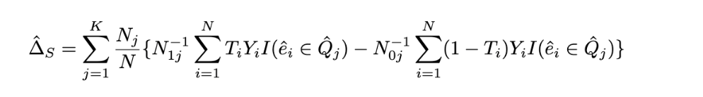
Stratification
Divides data into several stratas and computes causal effects using estimated propensity scores within each strata.
Shortcoming: does not work well under a large sample size due to residual confounding
Choosing the optimal number of stratums becomes one important consideration for estimation

Slide 7

Evaluation criteria
ATE score: average treatment effect in the whole population
Used to compare treatments effect in randomized experiments
Computational Efficiency: Computer run time
Notes:
Measures the difference between units in the control and treatment groups.

Slide 8
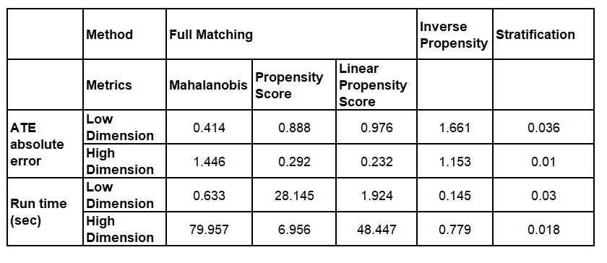
Results

Slide 9
Best Algorithm
Low Dimensional Data set: Stratification
High Dimensional Data set: Stratification

Slide 10
Thank you for your attention!

